Slide 1
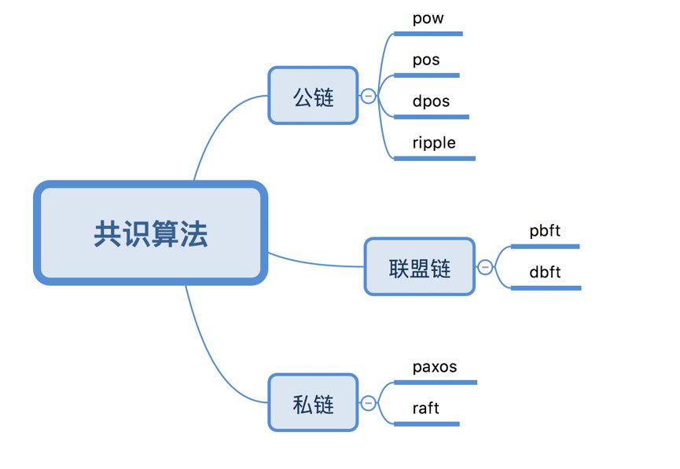
Notes:
https://zhuanlan.zhihu.com/p/35847127
对于 raft 算法，共识过程就是：只要老大还没挂，老大说什么，我们（团队普通成员）就做什么，坚决执行。那什么时候重新老大呢？只有当老大挂了才重选老大，不然生是老大的人，死是老大的鬼。
对于 pbft 算法，共识过程就是：老大向我发送命令时，当我认为老大的命令是有问题时，我会拒绝执行。就算我认为老大的命令是对的，我还会问下团队的其它成员老大的命令是否是对的，只有大多数人 （2f+1） 都认为老大的命令是对的时候，我才会去执行命令。那什么时候重选老大呢？老大挂了当然要重选，如果大多数人都认为老大不称职或者有问题时，我们也会重新选择老大。

Slide 2
PBFT算法的基本流程主要有以下四步：
1. 客户端发送请求给主节点
2. 主节点广播请求给其它节点，节点执行 pbft 算法的三阶段共识流程。
3. 节点处理完三阶段流程后，返回消息给客户端。
4. 客户端收到来自 f+1 个节点的相同消息后，代表共识已经正确完成。

Slide 3
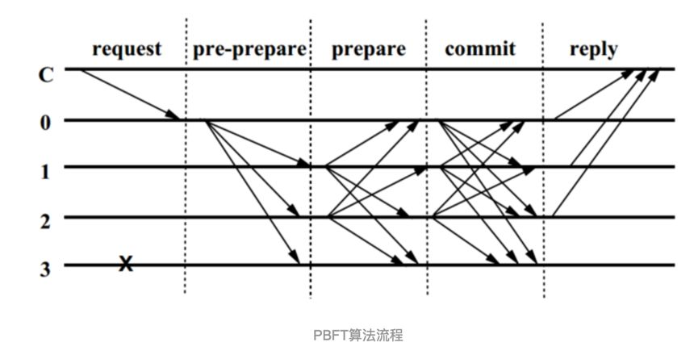

Slide 4
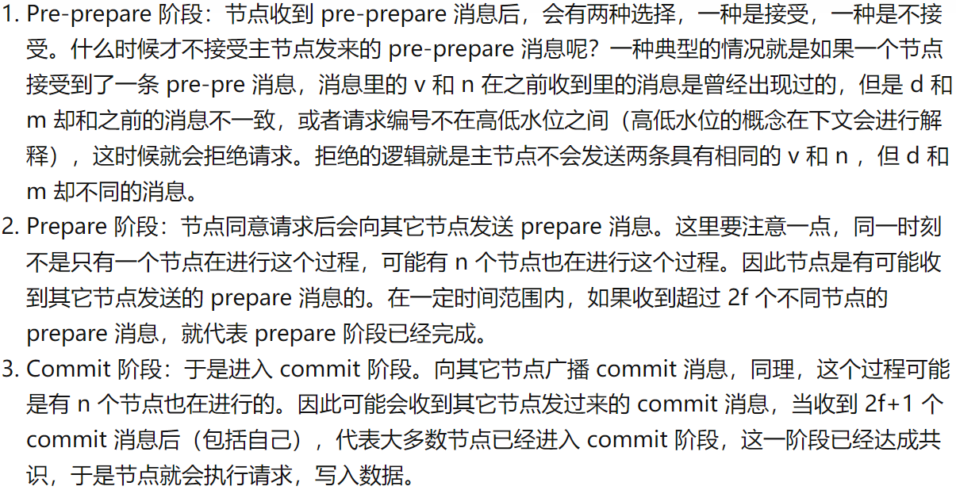

Slide 5
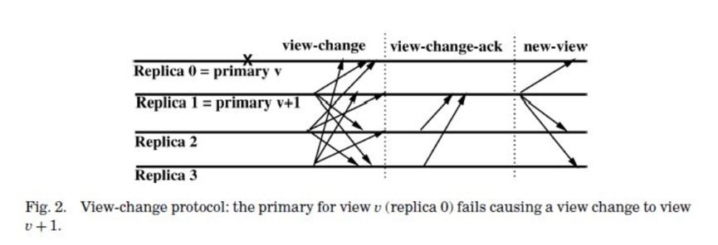
Notes:
当主节点挂了（超时无响应）或者从节点集体认为主节点是问题节点时，就会触发 ViewChange 事件， ViewChange 完成后，视图编号将会加 1 。

Slide 6
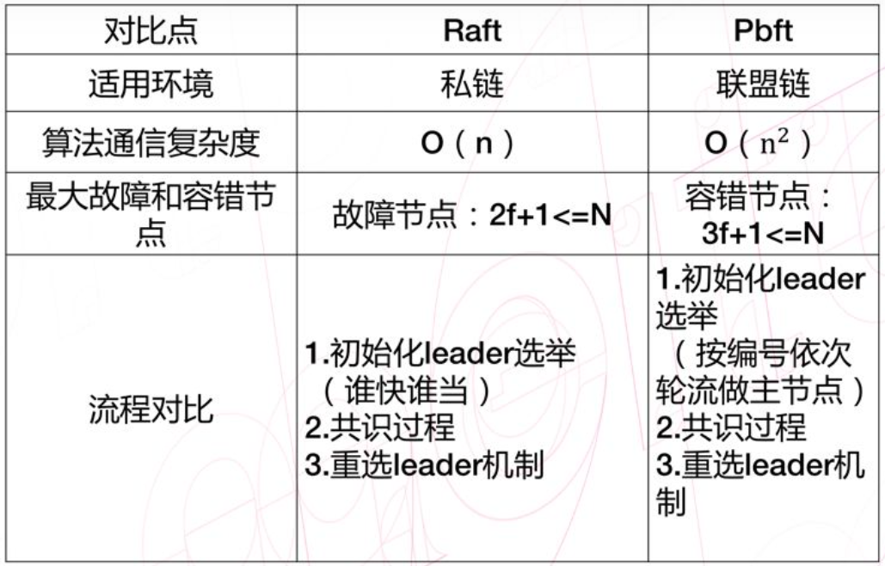
Notes:
一个团队一定会有一个老大和普通成员。对于 raft 算法，共识过程就是：只要老大还没挂，老大说什么，我们（团队普通成员）就做什么，坚决执行。那什么时候重新老大呢？只有当老大挂了才重选老大，不然生是老大的人，死是老大的鬼。
对于 pbft 算法，共识过程就是：老大向我发送命令时，当我认为老大的命令是有问题时，我会拒绝执行。就算我认为老大的命令是对的，我还会问下团队的其它成员老大的命令是否是对的，只有大多数人 （2f+1） 都认为老大的命令是对的时候，我才会去执行命令。那什么时候重选老大呢？老大挂了当然要重选，如果大多数人都认为老大不称职或者有问题时，我们也会重新选择老大。

Slide 7
Byzantine Fault Tolerance
Notes:
You’ve read about failures earlier in the course, but today is about different kind of failures

Slide 8
Reading List
L. Lamport, R. Shostak, M. Pease, “The Byzantine Generals Problem,” ACM ToPLaS 1982.
M. Castro and B. Liskov, “Practical Byzantine Fault Tolerance,” OSDI 1999.

Slide 9
Problem
Computer systems provide crucial services
Computer systems fail
Crash-stop failure
Crash-recovery failure
Byzantine failure
Example: natural disaster, malicious attack, hardware failure, software bug, etc.
Need highly available service
Replicate to increase availability

Slide 10
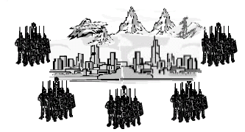
Byzantine Generals Problem
All loyal generals decide upon the same plan
A small number of traitors can’t cause the loyal generals to adopt a bad plan
Attack
Attack/Retreat
Attack
Retreat
Attack/Retreat
Solvable if more than two-third of the generals are loyal

Slide 11
Practical Byzantine Fault Tolerance
Before PBFT: BFT was considered too impractical in practice
Practical replication algorithm
Weak assumption (BFT, asynchronous)
Good performance
Implementation
BFT: A generic replication toolkit
BFS: A replicated file system
Performance evaluation
Byzantine Fault Tolerance in Asynchronous Environment

Slide 12

Challenges
Request A
Request B
Client
Client

Slide 13
Challenges
Client
Client
1: Request A
2: Request B
Notes:
Operations are deterministic
Replicas start in the same state

Slide 14
State Machine Replication
Client
Client
How to assign sequence number to requests?
1: Request A
1: Request A
1: Request A
1: Request A
2: Request B
2: Request B
2: Request B
2: Request B

Slide 15
Primary Backup Mechanism
Client
Client
What if the primary is faulty?
Agreeing on sequence number
Agreeing on changing the primary (view change)
1: Request A
2: Request B
View 0

Slide 16
Agreement
Certificate: set of messages from a quorum
Algorithm steps are justified by certificates
Quorums have at least 2f + 1 replicas
Quorum A
Quorum B
Quorums intersect in at least one correct replica

Slide 17
Algorithm Components
Normal case operation
View changes
Garbage collection
State transfer
Recovery
All have to be designed to work together

Slide 18
Normal Case Operation
Three phase algorithm:
PRE-PREPARE picks order of requests
PREPARE ensures order within views
COMMIT ensures order across views
Replicas remember messages in log
Messages are authenticated
{.}_{σk} denotes a message sent by k
Quadratic message exchange

Slide 19
Pre-prepare Phase
Request: m
{PRE-PREPARE, v, n, m}_{σ0}
Primary: Replica 0
Replica 1
Replica 2
Fail
Replica 3

Slide 20
Prepare Phase
Request: m
PRE-PREPARE
Primary: Replica 0
Replica 1
Replica 2
Fail
Replica 3
Accepted PRE-PREPARE

Slide 21
Prepare Phase
Request: m
PRE-PREPARE
Primary: Replica 0
{PREPARE, v, n, D(m), 1}_{σ1}
Replica 1
Replica 2
Fail
Replica 3
Accepted PRE-PREPARE

Slide 22
Prepare Phase
Request: m
Collect PRE-PREPARE + 2f matching PREPARE
PRE-PREPARE
Primary: Replica 0
{PREPARE, v, n, D(m), 1}_{σ1}
Replica 1
Replica 2
Fail
Replica 3
Accepted PRE-PREPARE

Slide 23
Commit Phase
Request: m
PRE-PREPARE
PREPARE
Primary: Replica 0
Replica 1
{COMMIT, v, n, D(m)}_{σ2}
Replica 2
Fail
Replica 3

Slide 24
Commit Phase (2)
Request: m
Collect 2f+1 matching COMMIT: execute and reply
PRE-PREPARE
PREPARE
COMMIT
Primary: Replica 0
Replica 1
Replica 2
Fail
Replica 3

Slide 25
View Change
Provide liveness when primary fails
Timeouts trigger view changes
Select new primary (= view number mod 3f+1)
Brief protocol
Replicas send VIEW-CHANGE message along with the requests they prepared so far
New primary collects 2f+1 VIEW-CHANGE messages
Constructs information about committed requests in previous views

Slide 26
View Change Safety
Goal: No two different committed request with same sequence number across views
Quorum for Committed Certificate (m, v, n)
View Change
Quorum
At least one correct replica has
Prepared Certificate (m, v, n)

Slide 27
Recovery
Corrective measure for faulty replicas
Proactive and frequent recovery
All replicas can fail if at most f fail in a window
System administrator performs recovery, or
Automatic recovery from network attacks
Secure co-processor
Read-only memory
Watchdog timer
Clients will not get reply if more than f replicas are recovering

Slide 28
Sketch of Recovery Protocol
Save state
Reboot with correct code and restore state
Replica has correct code without losing state
Change keys for incoming messages
Prevent attacker from impersonating others
Send recovery request r
Others change incoming keys when r execute
Check state and fetch out-of-date or corrupt items
Replica has correct up-to-date state

Slide 29
Optimizations
Replying with digest
Request batching
Optimistic execution

Slide 30
Performance
Andrew benchmark
Andrew100 and Andrew500
4 machines: 600 MHz, Pentium III
3 Systems
BFS: based on BFT
NO-REP: BFS without replication
NFS: NFS-V2 implementation in Linux
No experiment with faulty replicas
Scalability issue: only 4 & 7 replicas

Slide 31
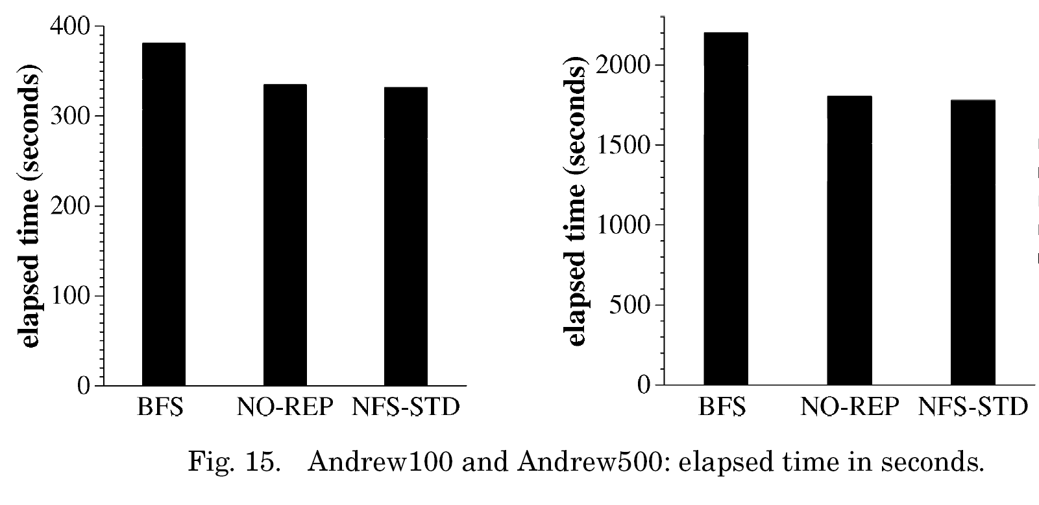
Benchmark Results
Without view change and faulty replica!
Notes:
Although they have some data on view change time – that’s artificial view change!

Slide 32
Related Works
Fault Tolerance
Fail Stop Fault Tolerance
Byzantine Fault Tolerance
Byzantine Agreement
Byzantine Quorums
Hybrid Quorum
Rampart TPDS 1995
SecureRing HICSS 1998
PBFT OSDI ‘99
Malkhi-Reiter JDC 1998
Phalanx SRDS 1998
Fleet ToKDI ‘00
Q/U SOSP ‘05
HQ Replication OSDI ‘06
Paxos 1989 (TR)
VS Replication PODC 1988
BASE TOCS ‘03

Slide 33
Questions?

